Slide 1
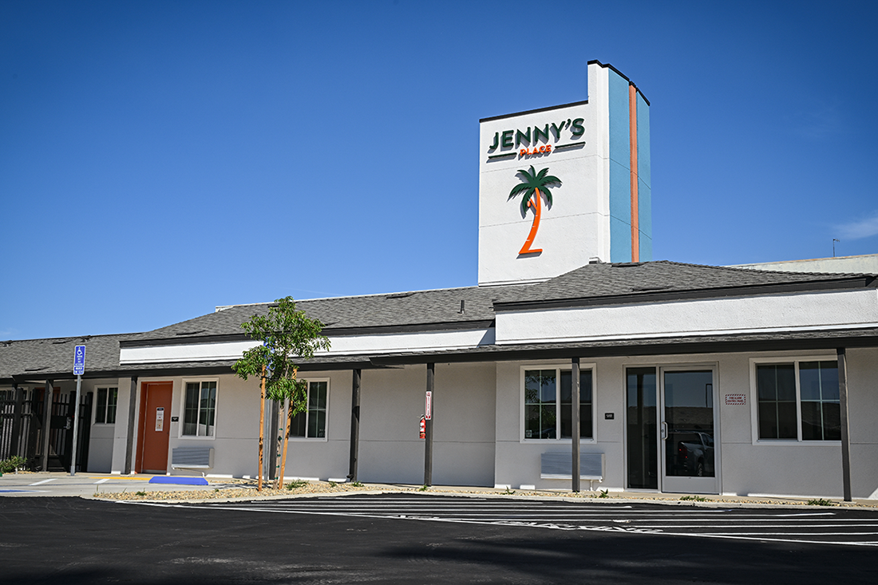

Hope has a home at
Jenny’s Place

Slide 2

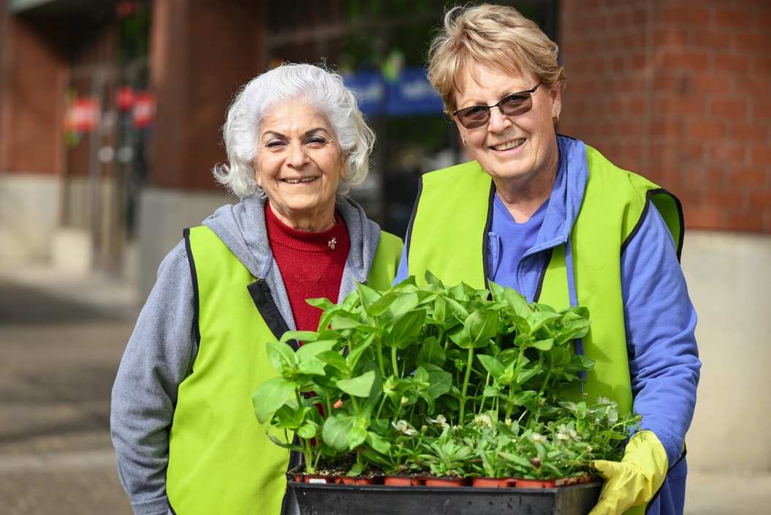
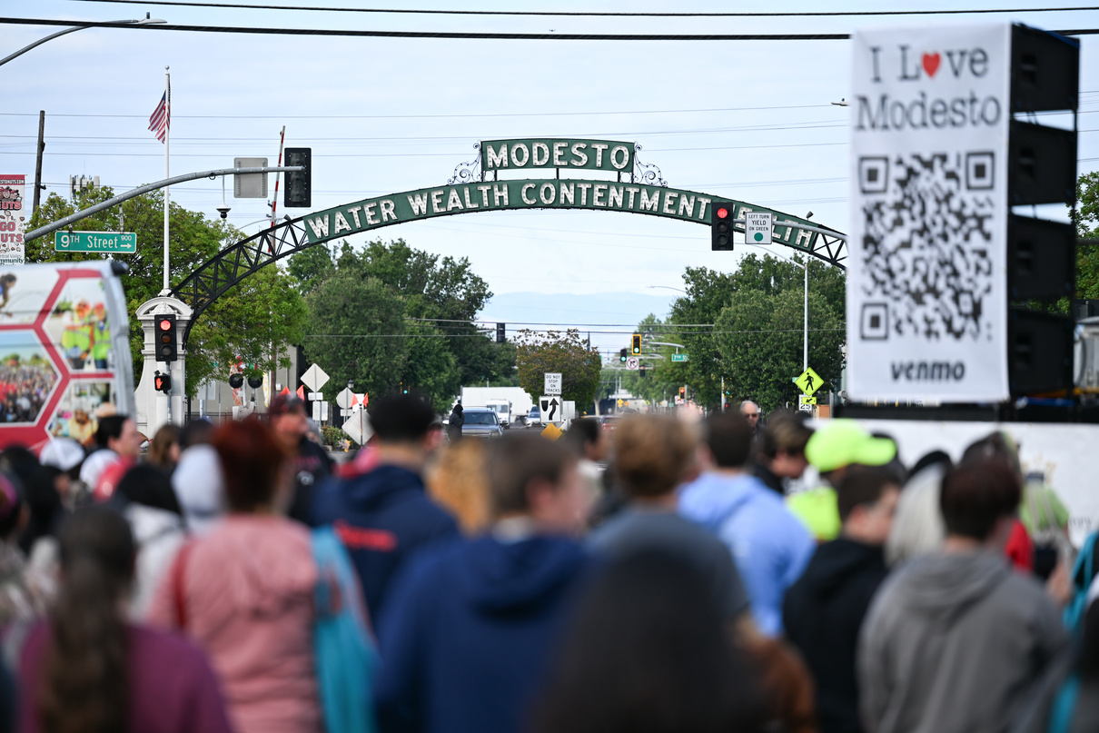
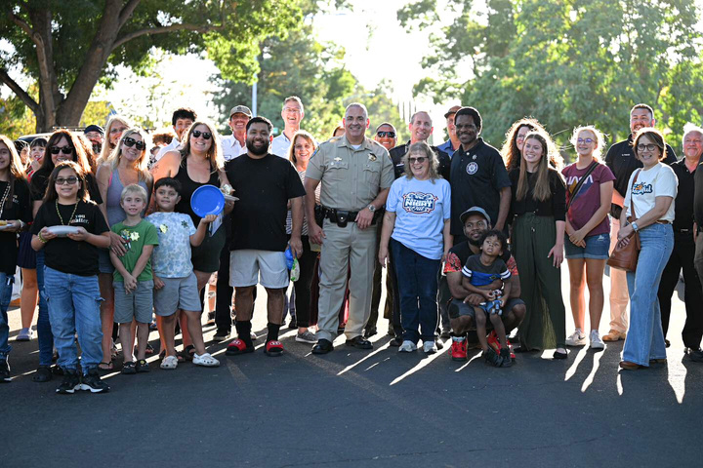
The City of Modesto
Modesto is an amazing community that has something to offer everyone; a vibrant downtown bursting with great restaurants, movies, shows, and festivals with unique neighborhoods, wonderful family-friendly parks and beautiful trees.
  Located in the heart of California
  Population of 218,455
  Median Income of $82,522
IN THE PROGRAM YEAR OF 2025-2026, MODESTO RECEIVED:
  CDBG - $1,898,921
  ESG - $157,694
  HOME - $800,216
TOTAL - $2,856,831
Notes:
Thematic goal is a single, contemporary, and qualitive rallying cry shared by all members of a team

Slide 3
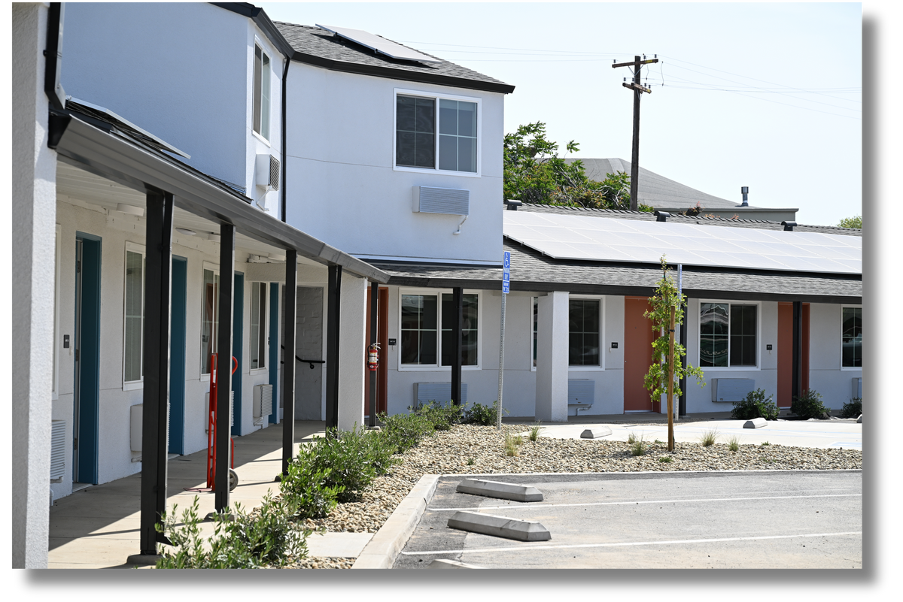
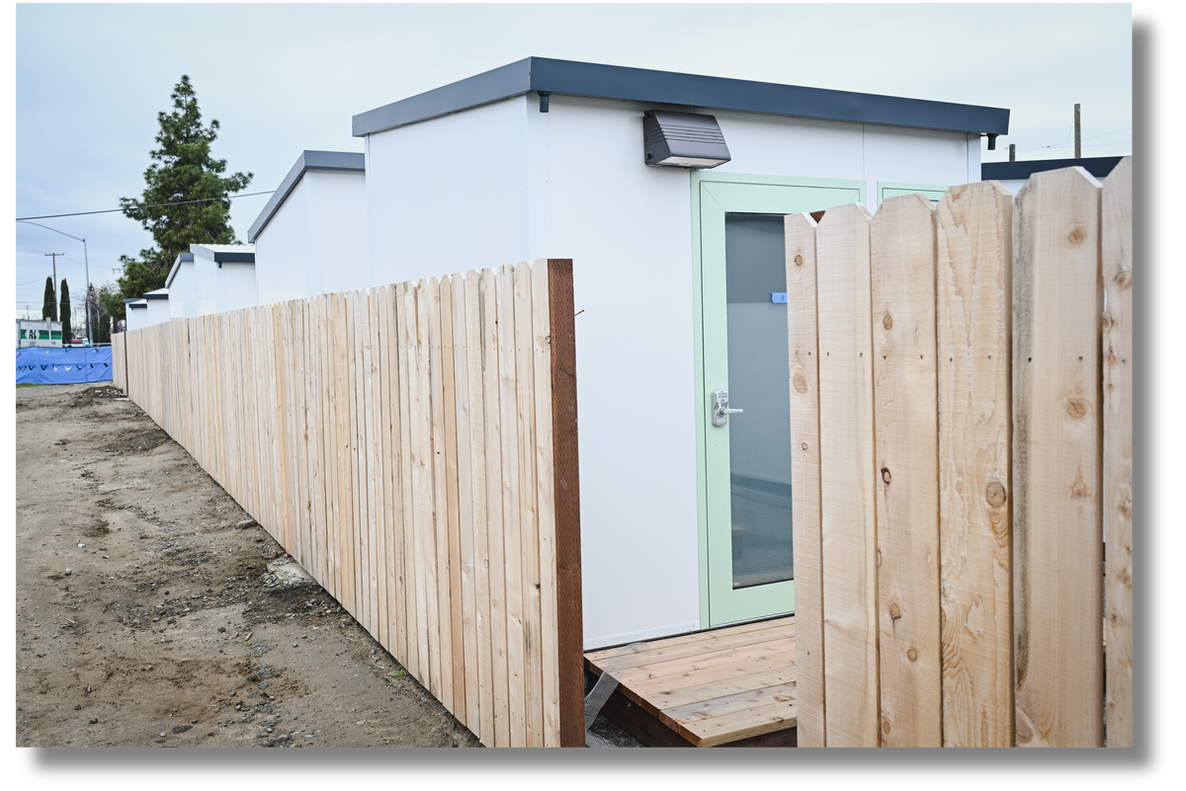
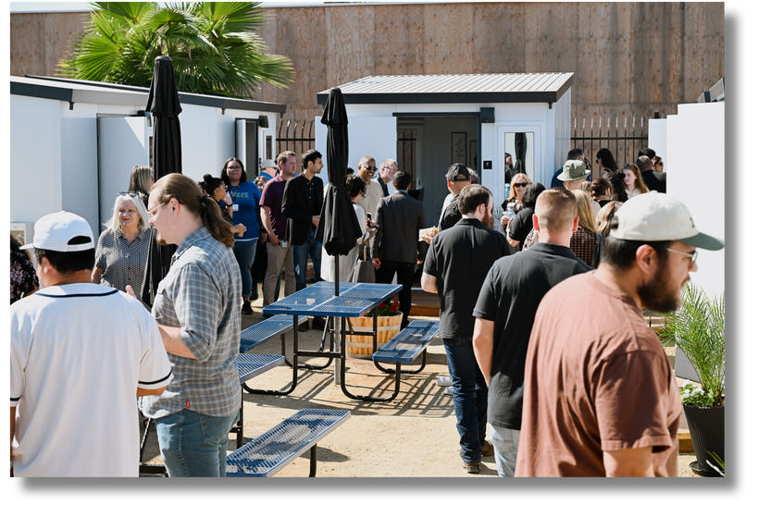
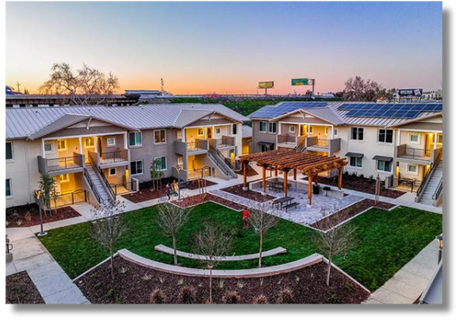
Modesto Develops Affordable Housing
Affordable housing is a top priority for the City of Modesto!
Jenny’s Place
Dignity Village
Grace Gardens
Archway Commons
Notes:
Thematic goal is a single, contemporary, and qualitive rallying cry shared by all members of a team

Slide 4

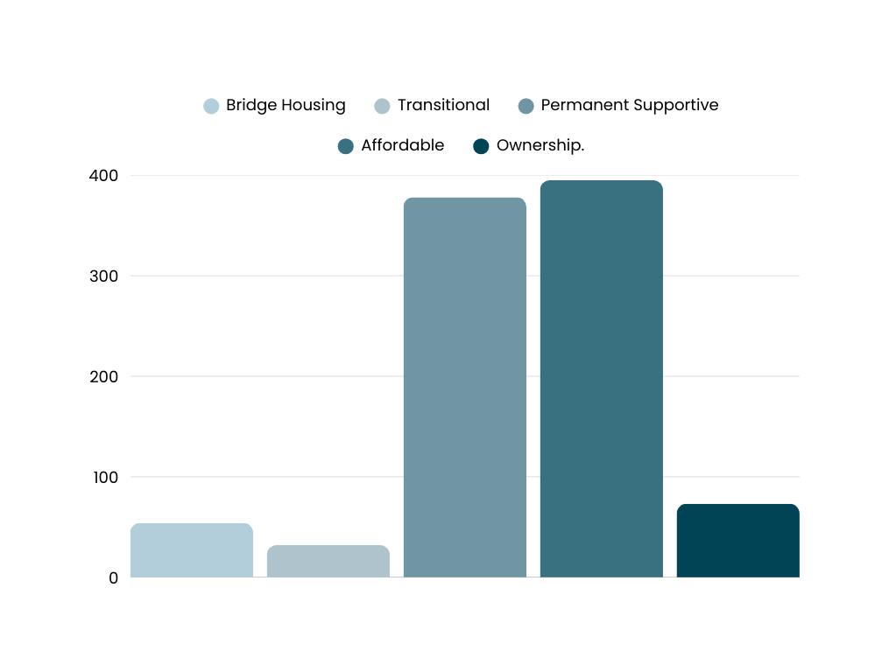
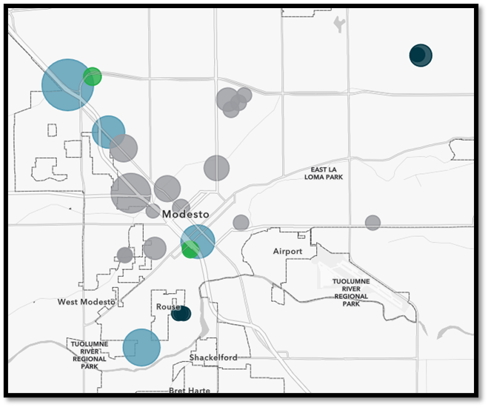
What Do We Do?
Affordable Housing Progress & Pipeline
378
395
54
73
32
GRAND TOTAL OF 932 UNITS

Slide 5

Housing Made Simple: Strategies for Streamlined Development
Development Liaison
Acts as the City’s primary point of contact, collaborating with affordable housing developers from initial design through occupancy to ensure projects progress smoothly and are delivered on time.
Development
Liaison
Project Streamlining
A coordinated approach that eliminates unnecessary delays by ensuring seamless communication between stakeholders throughout planning and permitting, enabling faster approvals and efficient project delivery.
Fund Development & Partnership
Project
Streamlining
Fund Development & Partnership
Working alongside developers and stakeholders to identify, secure, and leverage funding opportunities that support project success, ensuring resources are aligned with timelines and community goals.
Notes:
Thematic goal is a single, contemporary, and qualitive rallying cry shared by all members of a team

Slide 6
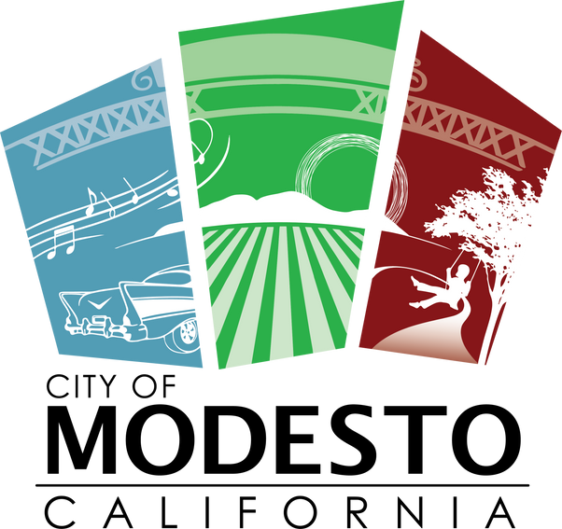
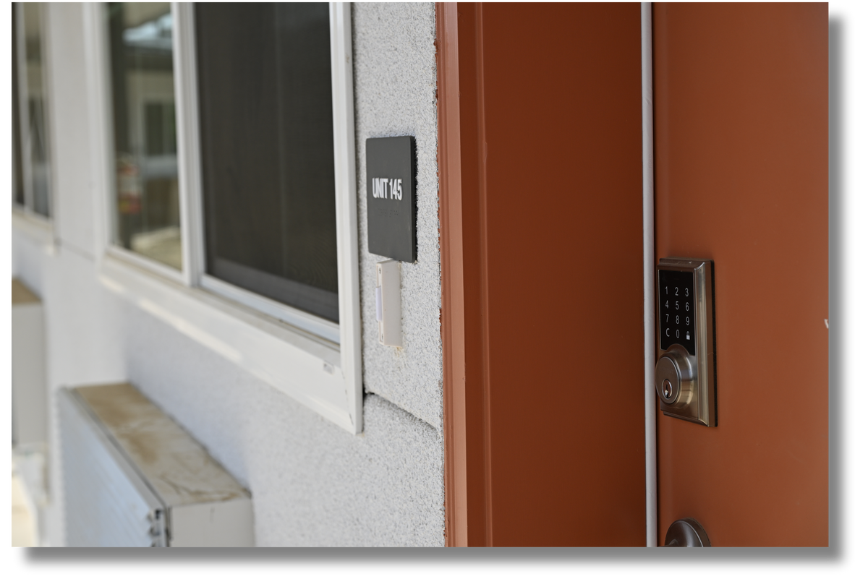
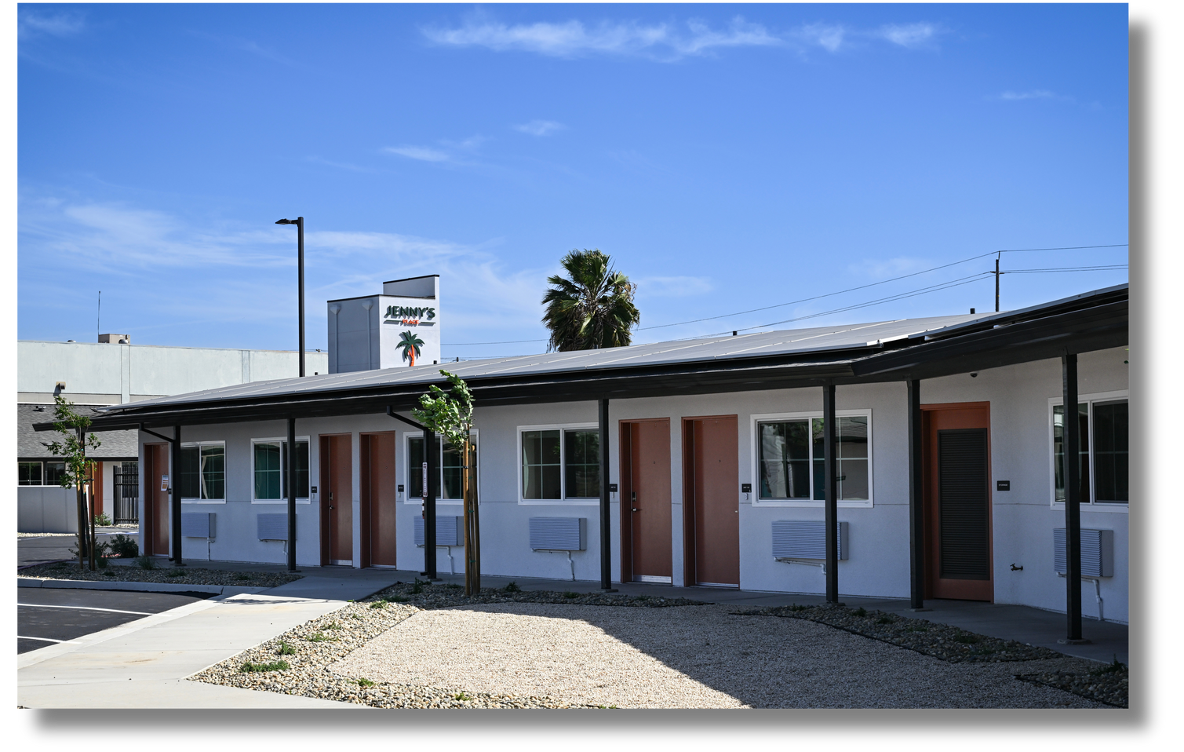
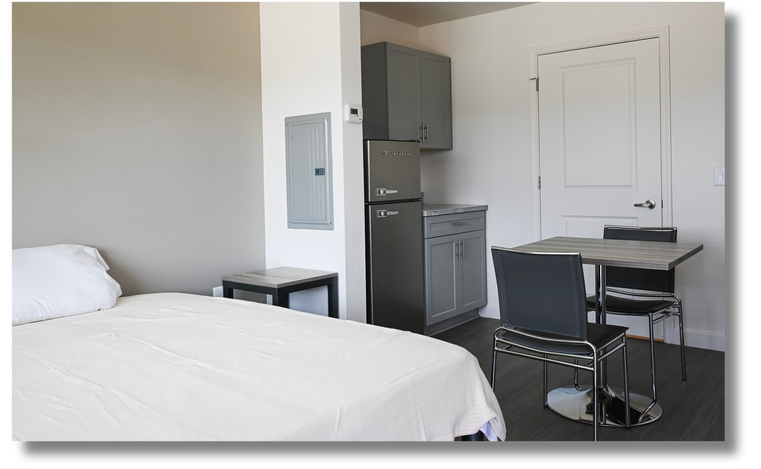

Jenny’s Place
From Blueprint to Move-In: Collaboration for Timely Affordable Housing
2022
2023
2023-2024
2025
2025
Modesto issued an Open Notice of Funding Availability.
Upholdings & RH Developers proposed the conversion of the Travelers Motel.
The City partnered with local, state, & health care system fundings to secure the needs of the project and began construction in February
Project completed construction in April 2025 and started lease-up activities.
Jenny’s Place was fully occupied by May 2025
Notes:
Thematic goal is a single, contemporary, and qualitive rallying cry shared by all members of a team

Slide 7
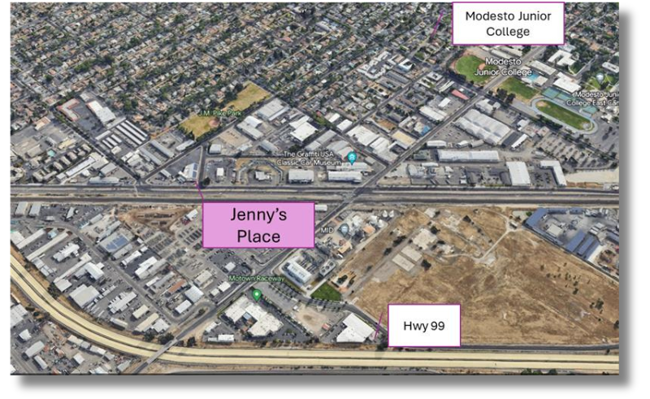
Project Location & Details
Location
710 N. 9th Street, Modesto, CA
Site of the former Traveler’s Motel
Zoning
Industrial
Areas of Interest
Walking distance to parks, Modesto Junior College, & the Youth Navigation Center
Notes:
Thematic goal is a single, contemporary, and qualitive rallying cry shared by all members of a team

Slide 8
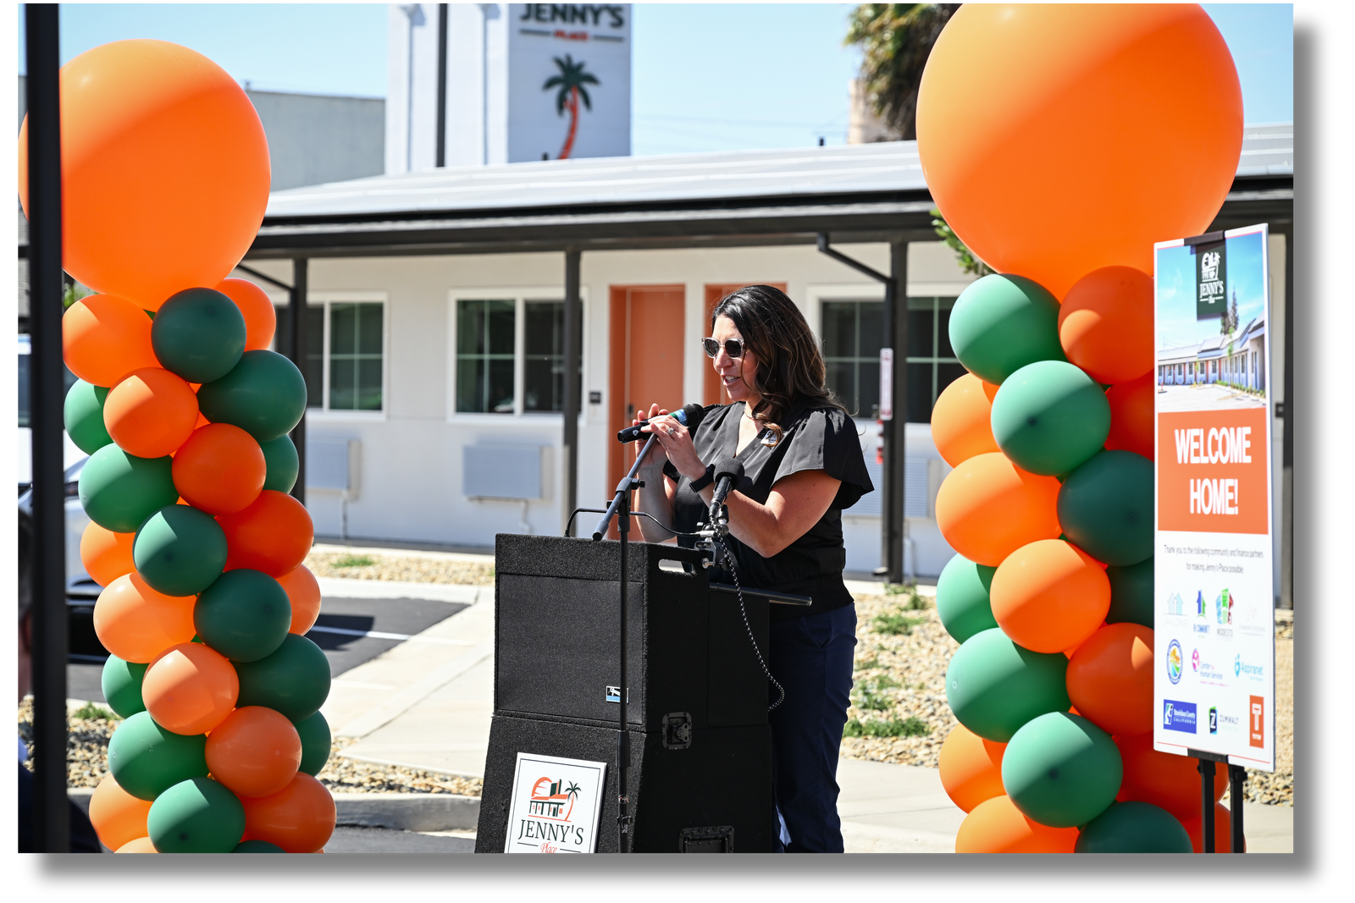
Jenny’s Place Development
Partnerships that Transform: Building Homes, Building Hope
Funding Partnerships | Amounts
Modesto HOME-ARP | $2,800,000
Modesto HOME Investment Partnership Program | $673,712
Total Modesto Commitment | $3,473,712
Local Community Investments
Stanislaus County Community System of Care (CoC) | $1,775,077
Cal-AIM Health Plan of San Joaquin | $2,150,000
Total Local Community Investments | $3,925,077
Total State of California Homekey Investment | $16,059,562
Total Developer Investment | $27,573
Total Cost for Development, Relocation, Initial Operations | $23,485,924

Slide 9

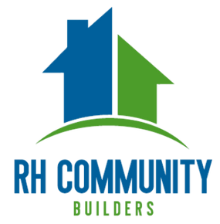




Project Partners
Working Hand-in-Hand: Building Homes Through Strong Partnerships
Development
Operations
Youth Services
Behavioral Health & Recovery Services
Oversee the property design & construction
Project planning & coordination
Case management & support services
Mental health & substance use services
On-going Operational Partners
Notes:
Thematic goal is a single, contemporary, and qualitive rallying cry shared by all members of a team

Slide 10
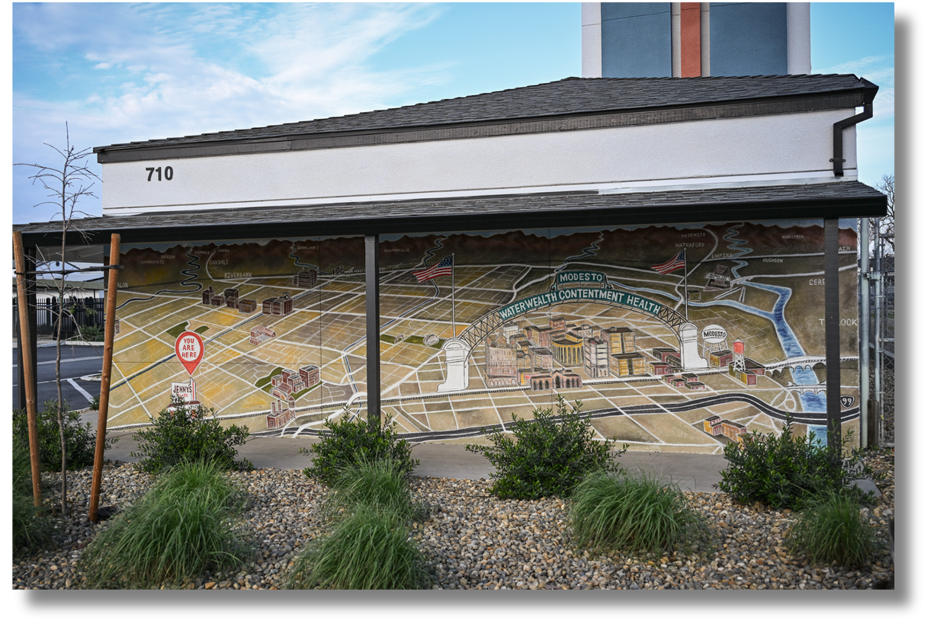
Jenny’s Place
Together the Modesto Community Build: Homes, Partnerships, and Possibilities
Total of 53 permanent supportive housing units dedicated to serving individuals experiencing homelessness.
  37 Youth
  16 Behavioral Health
The City assisted in securing over $20 million in State, local, & healthcare funds to support the construction, relocation, & operations.
Notes:
Thematic goal is a single, contemporary, and qualitive rallying cry shared by all members of a team

